Slide 1
Weapon Detection in Real-Time CCTV Videos Using Deep Learning
Batch No : 4
Battina Nandini(Y19CS003)
Choday Swetha(Y19CS024)
Chittemsetty Roopa Devi(Y19CS023)
Guided by
Dr. R. Lakshmi Tulasi
Incharge:
Dr. B. Vara Prasad Rao

Slide 2
Contents
Abstract
Problem Statement
Introduction
Existing Systems
Requirements
Methodology
Dataset
Performance Calculation
UML Diagrams
Results
Conclusion
References

Slide 3
Abstract
Security and safety is a big concern for today’s modern world.
CCTV cameras are being used for surveillance and to monitor activities.
Necessity of a system that can automatically detect these illegal activities.
Implementation of binary classification assuming pistol class as the reference class and relevant confusion objects inclusion concept is introduced to reduce false positives and false negatives.
No standard dataset was available for real-time scenario so we made our own dataset by making weapon photos from our own camera, manually collected images from internet, extracted data from YouTube CCTV videos, through GitHub repositories.

Slide 4
Problem Statement
In this project, we tackle the problem of detecting the presence of weapons within an image.
We want to learn a function that given an image as input returns the presence and the location of the weapon.
Weapon detection presents some peculiar and significant challenges.
The work focuses on providing a secure place using CCTV footage as a source to detect harmful weapons by applying the state of the art open-source deep learning algorithms.

Slide 5
Introduction
The crime rate across the globe has increased mainly because of the frequent use of handheld weapons during violent activity.
CCTV cameras play an important role to overcome this problem and are considered to be one of the most important requirements for the security aspect.
CCTV operators has to monitor 20- 25 screens for 10 hours.
As the number of screens increases, the concentration of the person decreases considerably to monitor each screen with time.
The solution to aforementioned problem is to install surveillance cameras with the ability to automatically detect weapons and raise alarm to alert the operators or security personals.
This article presents an automatic detection and classification method of weapons for real-time scenario using state of the art deep learning models.

Slide 6
Existing System
The problem of detection and classification of objects in real-time started after major developments in the CCTV field, processing hardware, and deep learning models.
In previous years, A human has to be there all the time to monitor screens. CCTV operator has to monitor 20- 25 screens for 10 hours. He has to look, observe, identify, and control the situation that can be harmful to the individuals and the property.
Drawbacks:
As the number of screens increases, the concentration of the person decreases considerably to monitor each screen with time. It is impossible for the person monitoring the screens to keep the same level of attention all the time

Slide 7
Existing System(Contd…)
Most of the effort was related to concealed weapon detection (CWD)technique using image fusion.
They used IR image and visual fusion to detect hidden weapons in a situation where the image of the scene was present over and under exposed area.
Drawbacks:
Current techniques attain high precision by using various combinations of extractors and detectors, either by using easy intensity descriptors, boundary detection, and pattern matching or by using more complicated techniques such as cascade classifiers with boosting.
These systems were based on metal detection; non-metallic guns cannot be detected.
They were costly to use in many locations because they need to be coupled with X-ray scanners and conveyor belts.
They responds to all metallic objects, so were not accurate.

Slide 8
Existing Systems(Contd…)
In the past few years, deep learning in particular convolutional neural network (CNN) has given groundbreaking results in object categorizing and detection. It has achieved finest results thus far in classical problems of image processing such as grouping, detection and localization.
Drawbacks:
The first and main problem is the data through which CNN learn its features to be used later for classification and detection.
No standard dataset was available for weapons.
For real-time scenarios, making a novel dataset manually was a very long and time-consuming process.

Slide 9
Existing Systems(Contd…)
Labeling the desired database is not an easy task, as all data needs to be labeled manually.
Different detection algorithms were used, so a labeled dataset for one algorithm cannot be utilized for the other one.
Every algorithm requires different labeling and preprocessing operations for the same-labeled database.
As for real-time implementation, detection systems require the exact location of the weapon so gun blocking or occlusion is also a problem that arises frequently and it could occur because of self, inter-object, or background blocking.

Slide 10
Requirements
Software Requirements:
Operating system : Windows 10 and above
Language Requirement : Python
Hardware requirements:
Processor: i5 processor based computer
Good Internet Connectivity
Memory: 1GB
Hard Drive : 50GB

Slide 11
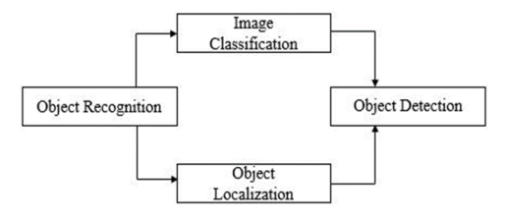
Methodology
The methodology adopted in this work features the state of art deep learning, especially the convolutional neural networks due to their exceptional performance in this field.
Object Recognition:
As the name suggests, it is the process of predicting the real class or category of an image to which it belongs by making probability high only for that particular class. CNN’s are used to efficiently perform this process.

Slide 12
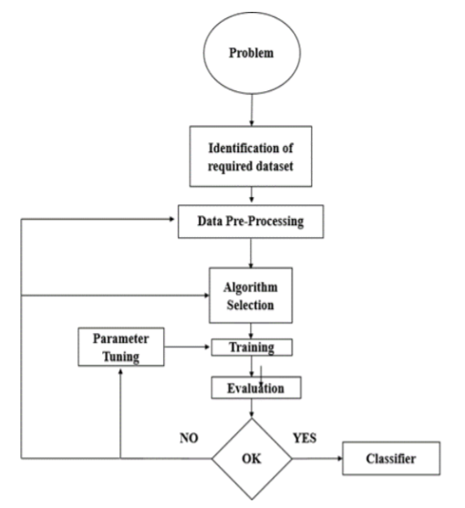
Methodology (contd…)
TRAINING MECHANISM:
The given figure describes the general methodology used in training and optimization.

Slide 13

Algorithm
YOLOV4:
YOLOv4 prioritizes real-time object detection and training takes place on a single CPU.
There are two types of models, one and two-staged object detectors.

Slide 14
Dataset
To train all those algorithms there is no public dataset available so author of this paper is creating his own dataset from CCTV images. So we have downloaded few KNIVES and GUNS images from Google to train algorithms.
The dataset include:
Knife
Guns

Slide 15
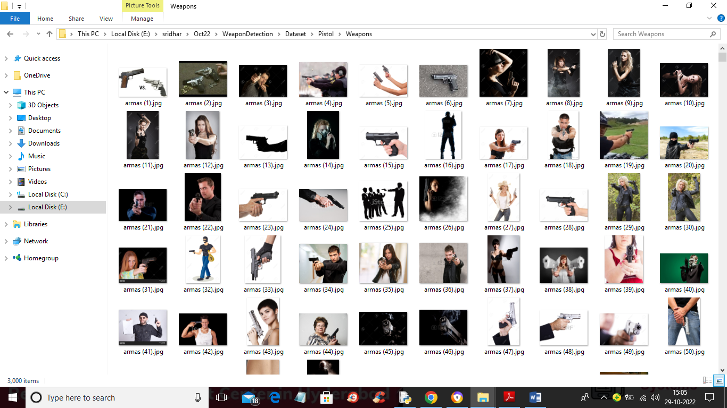

Slide 16
MODULES
To implement this project we have designed following modules:
Upload Weapon Dataset: using this module we will upload dataset to application
Load Yolov4 Weapon Detection Model: this will read dataset images and then trained or load Yolov4 model and then calculate its prediction accuracy
Upload Image: using this module we will upload test image
Detect Weapon from Image: using this module we will apply Yolov4 model on loaded image to detect weapon
Detect Weapon from Video: using this module we will upload video and then YoloV4 will analyse each frame in the video to detect weapon
Weapon Detection Training Accuracy-Loss Graph: using this module we will plot YoloV4 training accuracy and loss graph

Slide 17
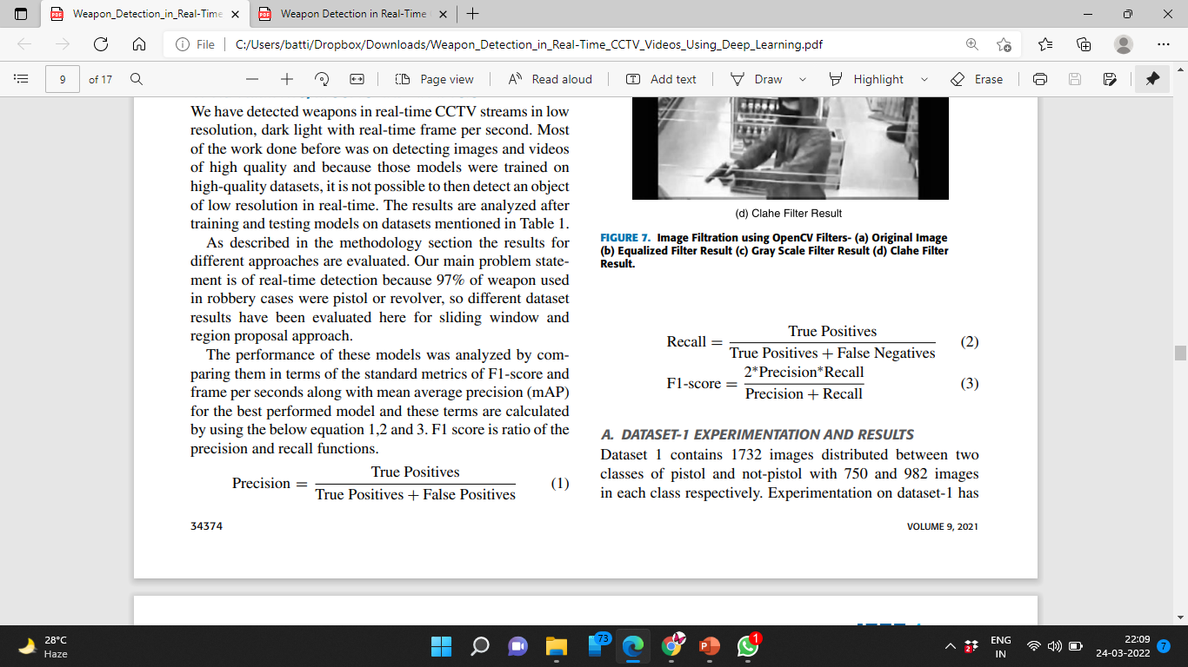
Performance Calculations
Precision:
It describes what proportion of positive identifications are actually correct.
Recall:
It describes what proportion of actual positives are identified correctly.

Slide 18
Performance Calculations
F1-Score:
It conveys the balance between the precision and the recall.

Slide 19
UML Diagrams

Slide 20
USECASE DIAGRAM

Slide 21
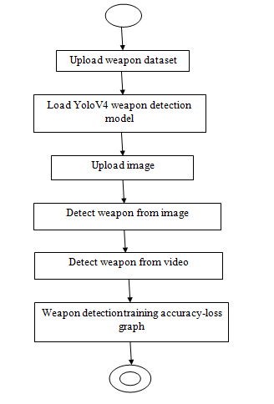
ACTIVITY DIAGRAM

Slide 22
SEQUENCE DIAGRAM

Slide 23
COLABORATION DIAGRAM

Slide 24
CLASS DIAGRAM

Slide 25
COMPONENT DIAGRAM

Slide 26
DEPLOYMENT DIAGRAM

Slide 27
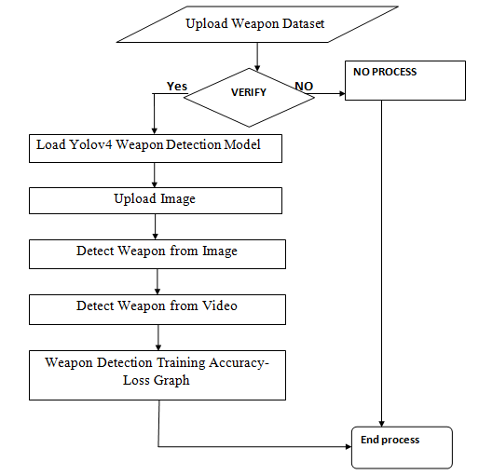
DATAFLOW DIAGRAM

Slide 28
Results

Slide 29
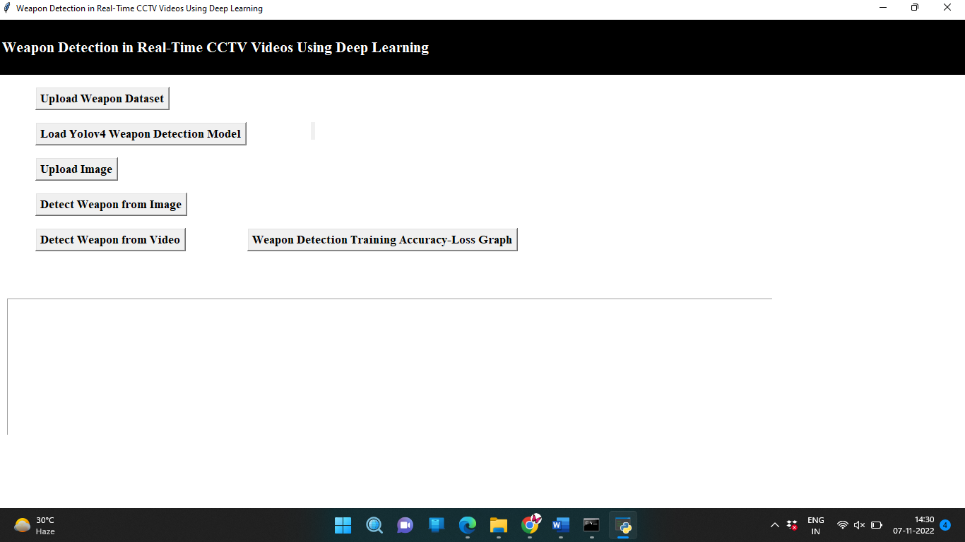

Slide 30
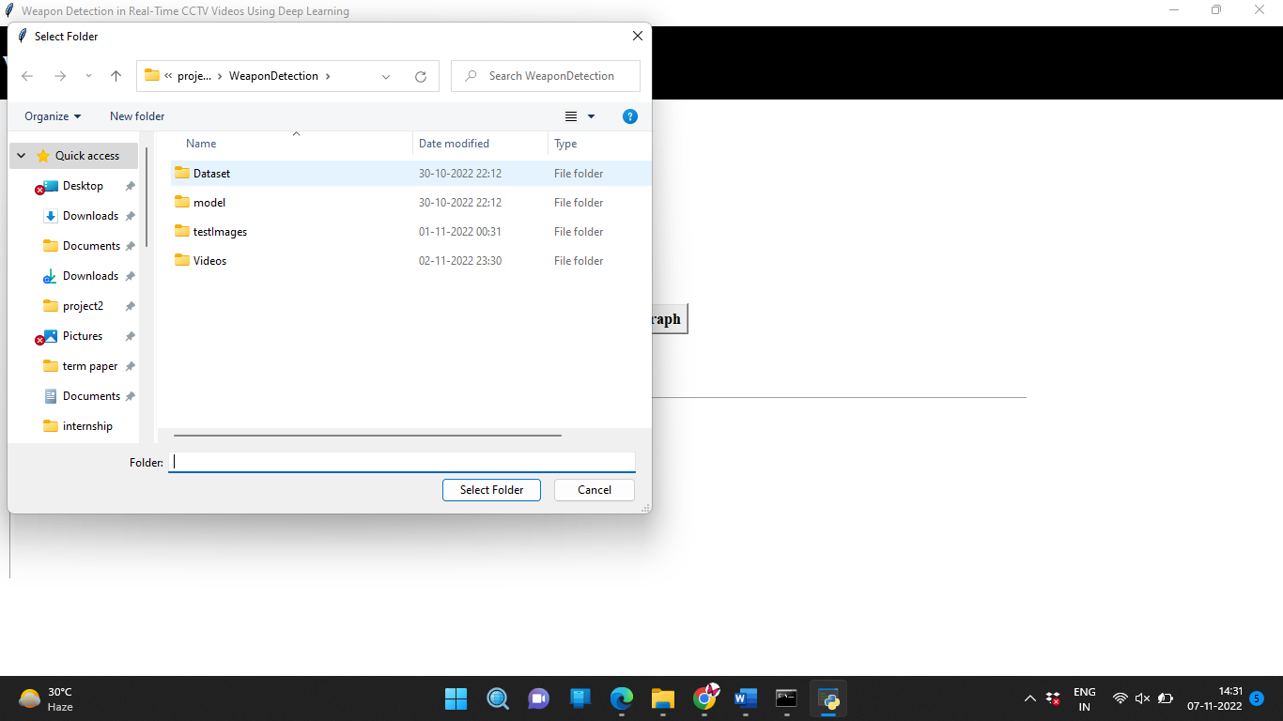

Slide 31
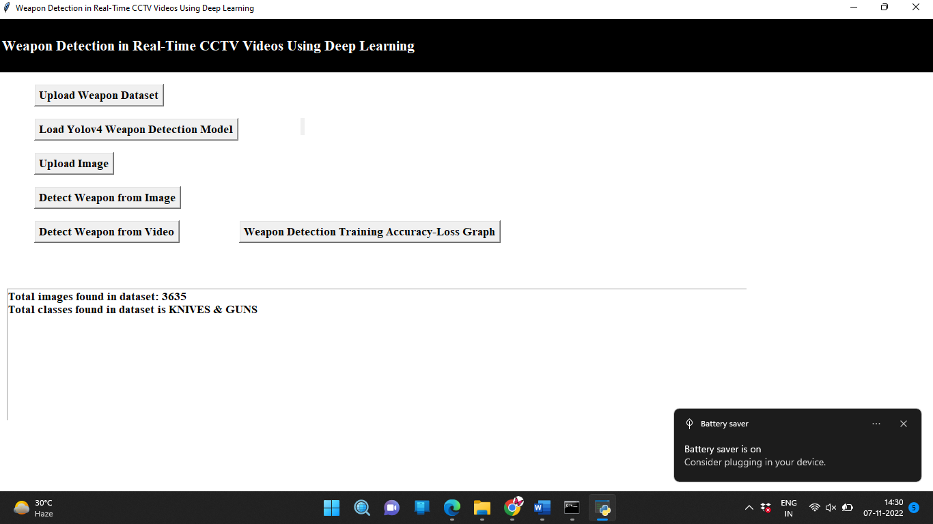

Slide 32
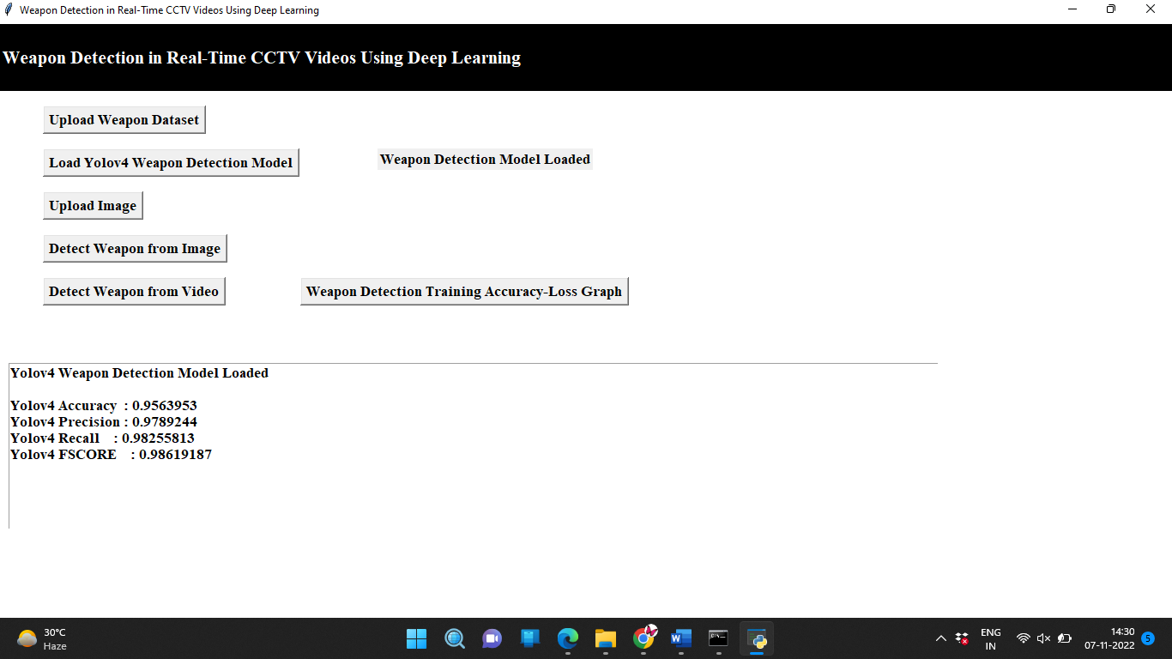

Slide 33
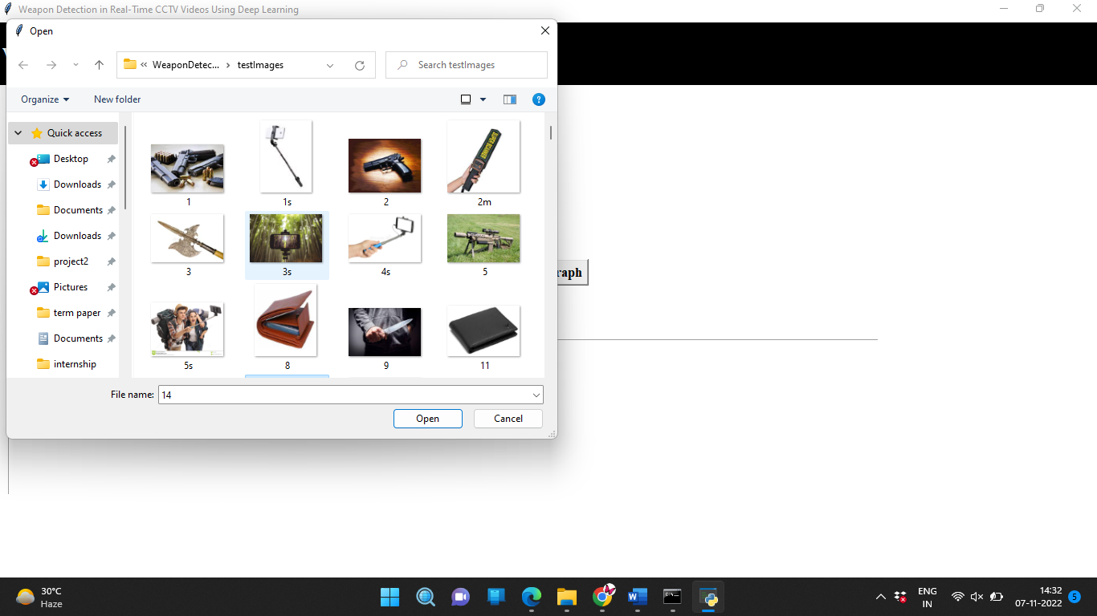

Slide 34
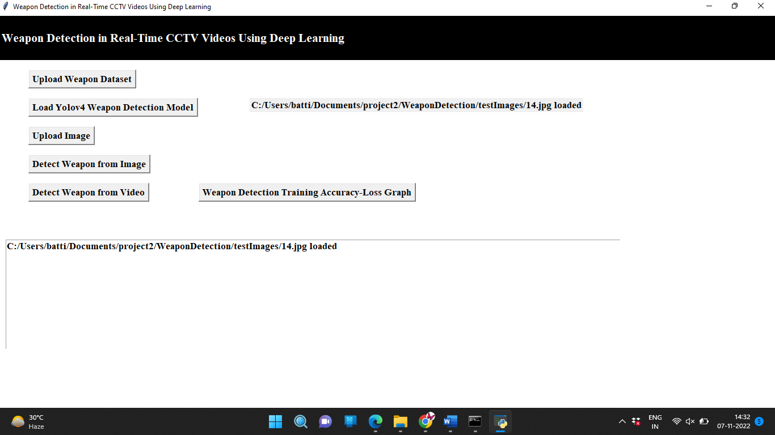

Slide 35
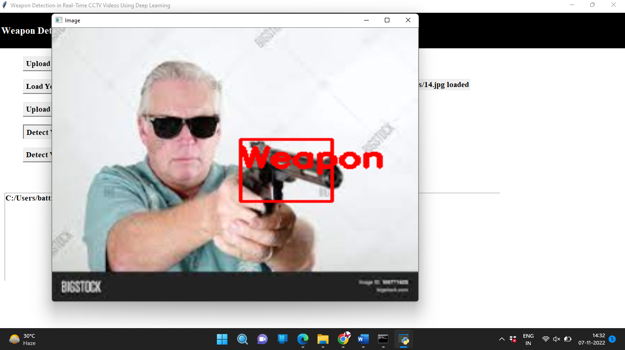

Slide 36
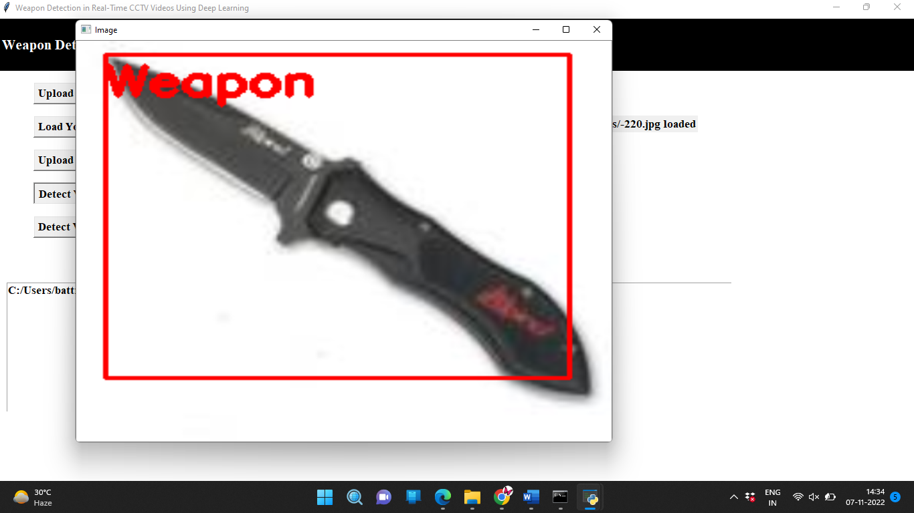

Slide 37
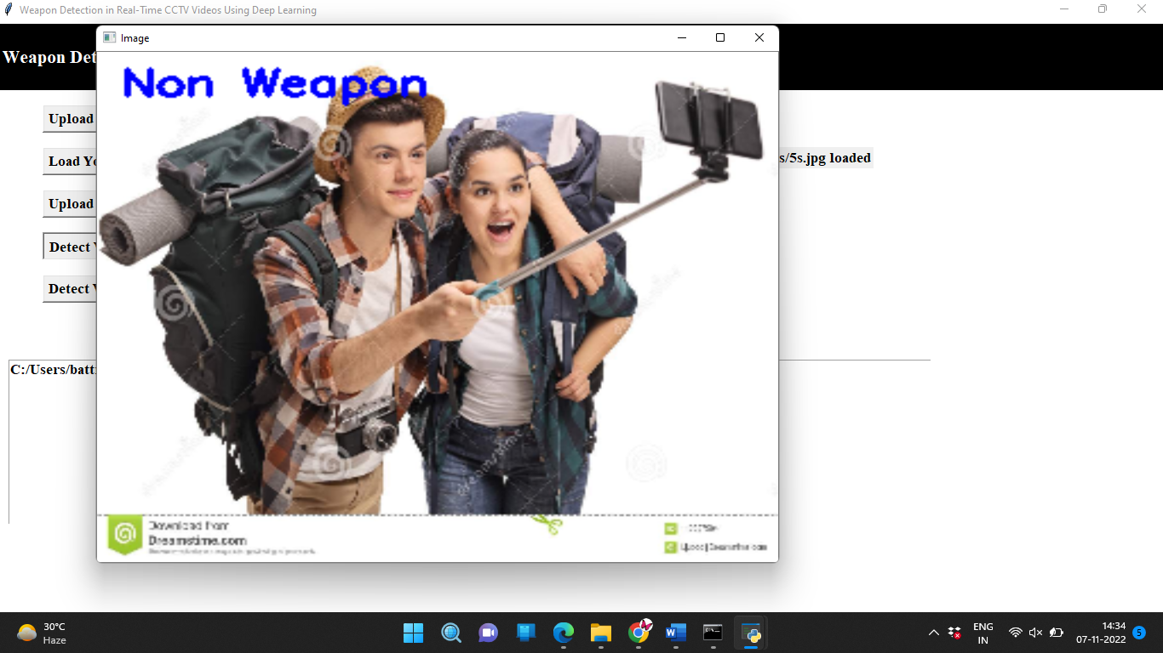

Slide 38
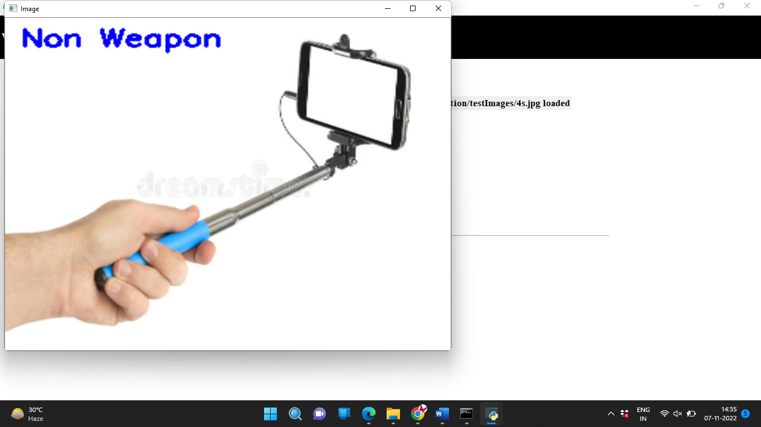

Slide 39
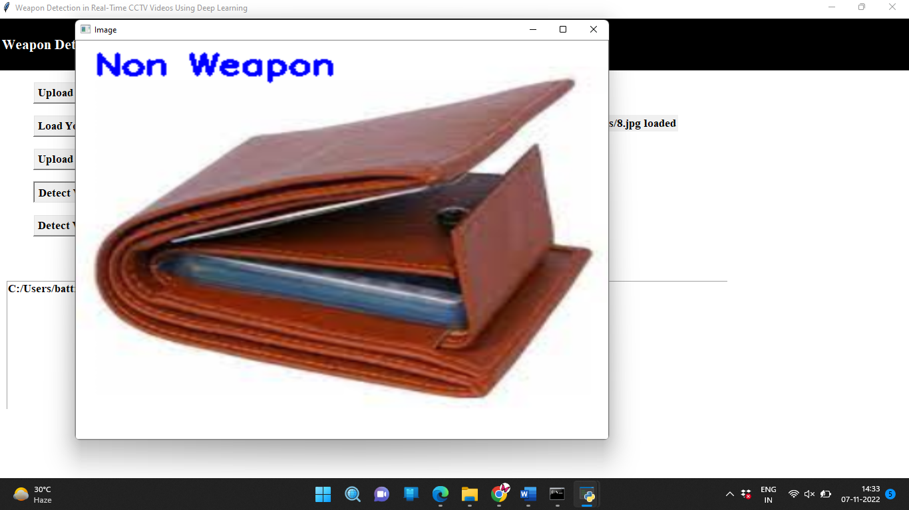

Slide 40
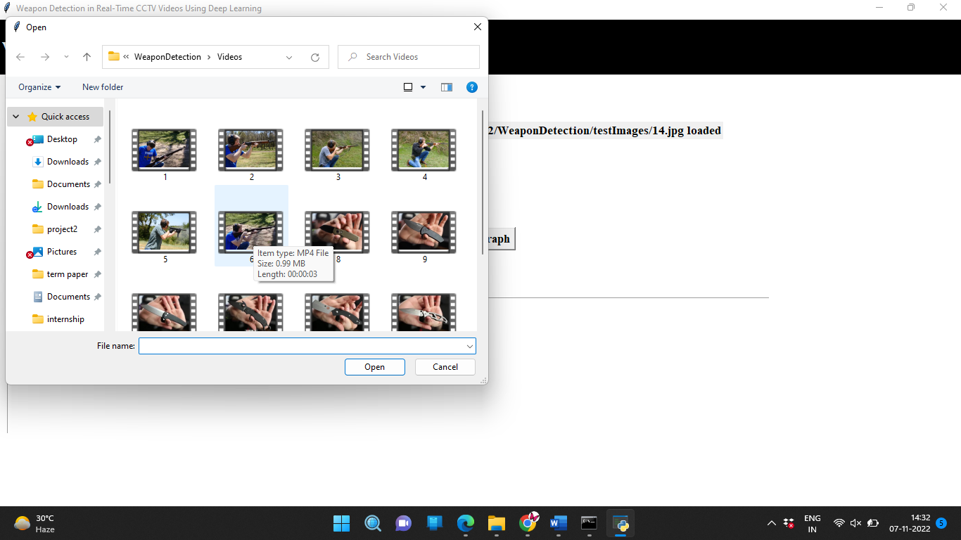

Slide 41
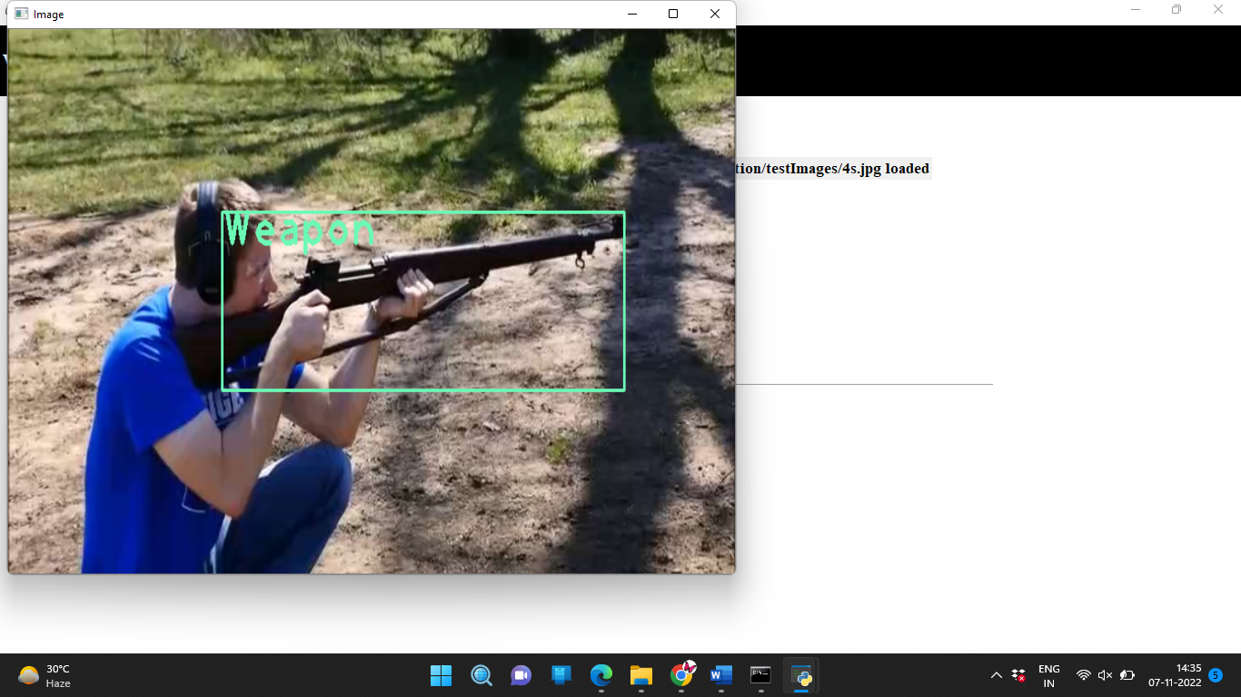

Slide 42
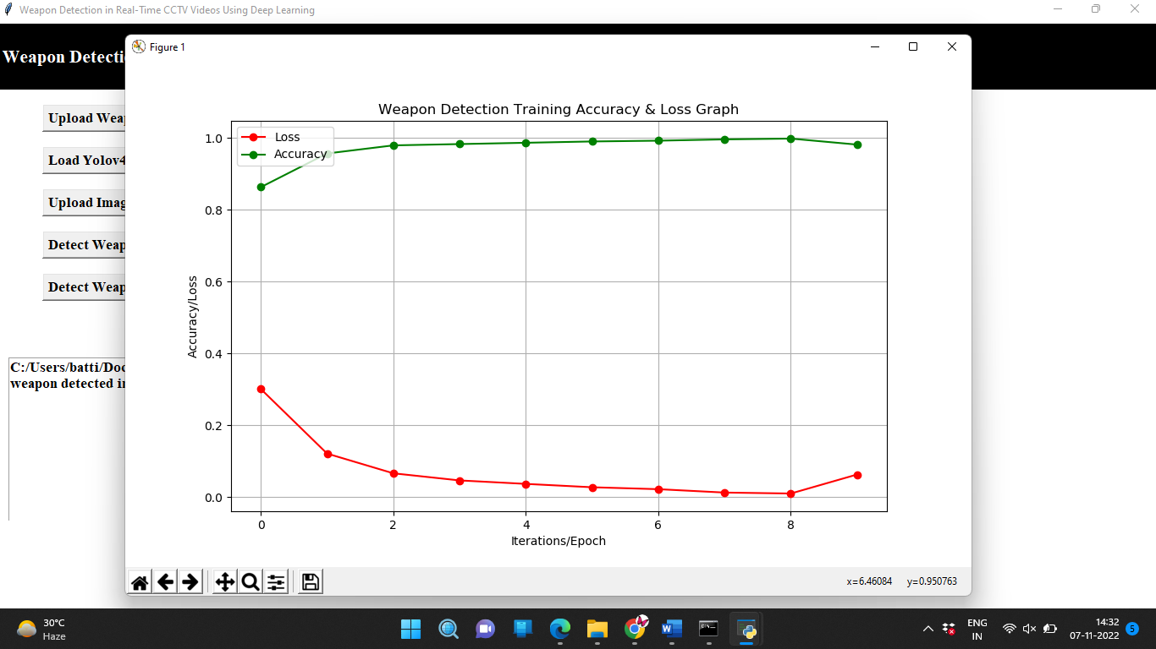

Slide 43
Conclusions
In this study, we focused on the two specific tasks of automated detection and recognition of illegal activities.
We have focused on detecting the weapon in live CCTV streams and at the same time reduced the false negatives and positives.
We have tested many models but among all of them, the state-of-the-art Yolov4, trained on our new database, gave very few false positive and negative values, hence achieved the most successful results

Slide 44
References
Z. Xiao, X. Lu, J. Yan, L. Wu, and L. Ren, ‘‘Automatic detection of concealed pistols using passive millimeter wave imaging,’’ in Proc. IEEE Int. Conf. Imag. Syst. Techn. (IST), pp. 1–4.
D. M. Sheen, D. L. Mcmakin, and T. E. Hall, ‘‘Three-dimensional millimeter-wave imaging for concealed weapon detection,’’ IEEE Trans. Microw. Theory Techn., vol. 49, no. 9, pp. 1581–1592, Sep. 2001.
Z. Xue, R. S. Blum, and Y. Li, ‘‘Fusion of visual and IR images for concealed weapon detection,’’ in Proc. 5th Int. Conf. Inf. Fusion, vol. 2, Jul. 2002, pp. 1198–1205.

Slide 45
Thank You

